Slide 1

Predicting Airline Flight Delay: An analysis of Bureau of Transportation Flight Data
MS-AAI-501 Intro to AI
University of San Diego Masters Program
Ned Kost, Brian Morris, Anova Youngers

Slide 2



Introduction
The airline industry is vital for both passengers and businesses, but flight delays can cause significant disruptions and inconveniences.
Ned Kost
Brian Morris
Anova Youngers
Carrier Employee Data
Logistic Regression
Gradient Boosting Classifier
Data Enrichment - Weather
Random Forest
Neural Network
Visualizations Significance Testing
Neural Network
Notes:
We each took over different dutie as we progressed through this project. We all worked on data exploration.
Ned supplemented the data with carrier employee data
Brian focused on data enrichment via weather enhancements

Slide 3



Business Problem
Cost to Passengers - $16.7 billion
Cost to Airlines - $8.3 billion
Cost to Environment - 5529 tons of extra fuel
Predicting and managing flight delays effectively is essential to mitigate financial losses for both passengers and airlines and reduce the environmental impact of air travel.
Notes:
When flights are delayed, passengers may incur expenses such as additional accommodation costs, missed connections, and rescheduling fees. The estimated cost of flight delays to passengers, as mentioned in our data, amounts to a substantial $16.7 billion.
Airlines also bear substantial financial burdens due to flight delays. These costs include compensation to passengers, crew overtime, and additional operational expenses
flight delays result in increased fuel consumption and greenhouse gas emissions.
To address this issue and enhance passenger experience and operational efficiency, we aim to develop a predictive model that forecasts flight delays accurately. Our goal is to provide airlines with a tool that can anticipate delays, enabling them to take proactive measures to mitigate disruptions, optimize scheduling, and improve overall service quality.

Slide 4



Datasets and Sources
Bureau of Transportation Statistics
On-Time flight performance (2020-2023)
Airline employment data by month
National Oceanic and Atmospheric Administration
Precipitation and windspeed weather data at airport origin and destination
Datasets Description
16.8M records (2020 – 2022) – full dataset
Highly imbalanced (16.77% delayed)
7M records after balancing full dataset (60-40%)
360,0000 balanced subset, randomly sampled and supplemented with weather data
70,000 records (2023) – test dataset

Slide 5
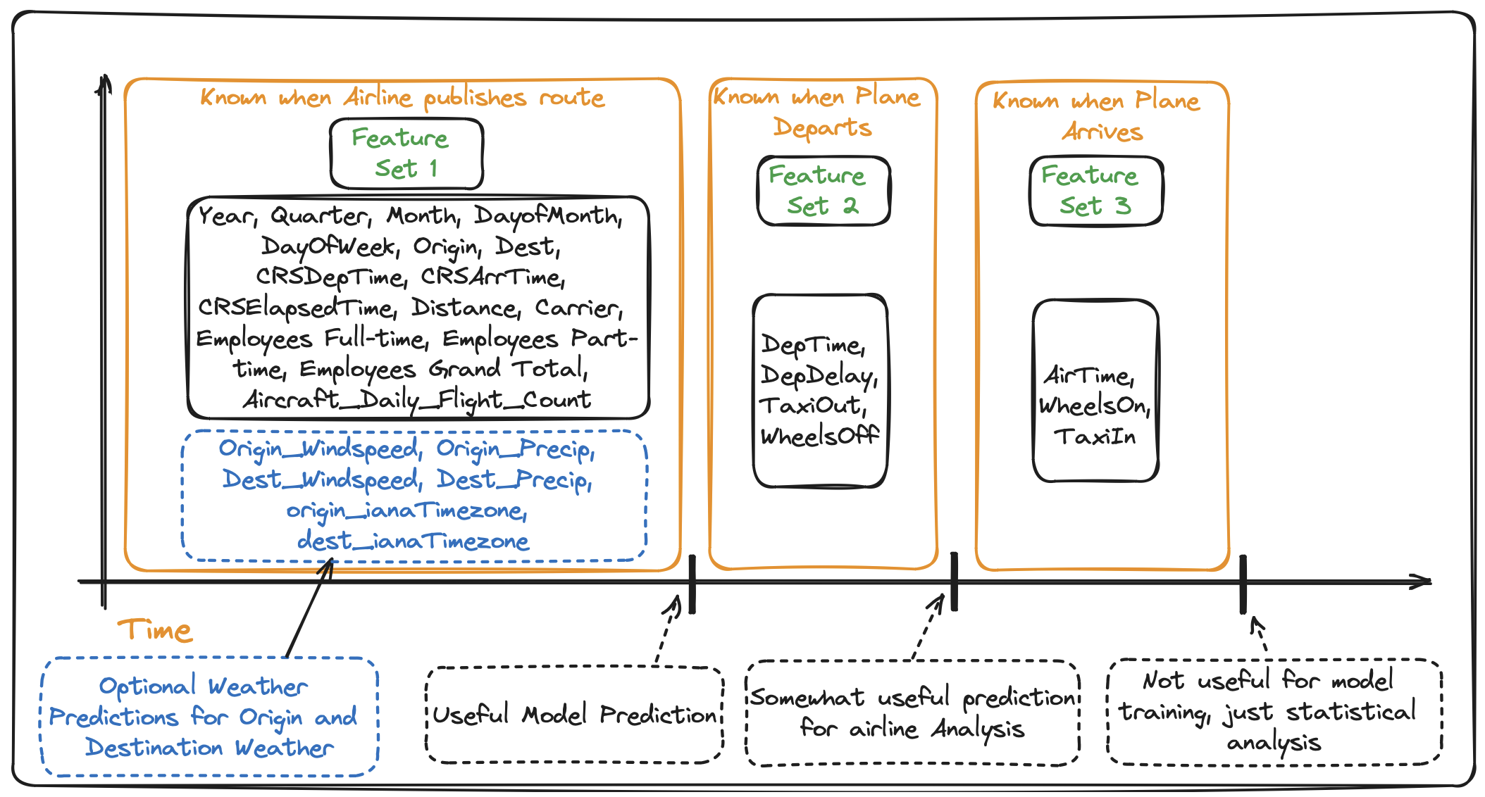
Feature Identification
Group possible features into distinct groups based off time known
Create models for different use cases dependent on feature set

Slide 6
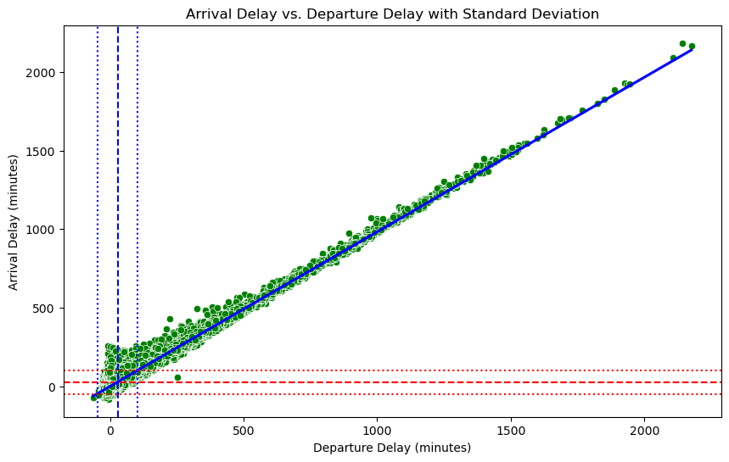




Models and Strategies
Logistic Regression using stastmodels GLM with logit link function
Strong linear relationship with departure delay and arrival delay
1 hour departure delay has 95% chance of arrival delay.
Gradient Boosting classifier using XGBoost
Hyperparameter tuning using StratefiedKFold and GridSearchCV from sklearn
Optimal learn rate =.1 and optimal n_estimators (tree depth) = 800
Random Forest
Hyperparameter tuning with Bayesian optimization
Tuned hyperparameters (small dataset): n_estimators=400, min_samples_split=2
Neural Net
Hyperparameter tuning 128/32/1, Cyclical Encoding of time features
Notes:
Logistic Regression model = Fast and simple to understand, tweak, and analyze
XGBoost = Experiment with Hyperparameter tuning. Additional parameters to explore would be gamma, min_child_weight, min_split_loss, scale_pos_weight
Neural net:minmax scalinf was an important preprocessing step used. MinMax scaling is crucial for neural networks because it normalizes the input features to a specific range (often 0 to 1), ensuring that no single feature dominates the learning process due to its scale. Now The model architecture I used has four dense layers of 128, 64, and 32 neurons respectively. The layers are interspersed with dropout layers to prevent overfitting. The final layer is a dense layer with a single neuron, well tailored for binary classification tasks. A batch size of 128 was deployed. The training process was consistent, maintaining an accuracy of around 83.21% from the very first epoch, both on training and validation data. 2nd model I did had 6 dense layers with neuron input starting at 256 and two extra dropout layers, the accuracy score stayed the same indicating more complex models do not neccairly guarantee better results.

Slide 7
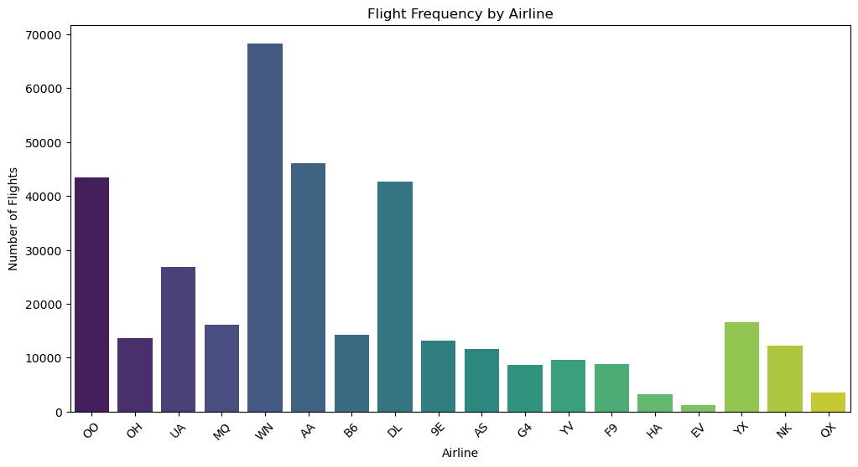
Challenges
Categorical encoding:
One-Hot Encoding ‘Carrier’ (15)
Binary encoding for airport Origins and Destinations (374)
Balancing dataset:
SMOTE: Synthetic Minority Over-Sampling Technique
Under-sampling the majority class (60/40)
Overfitting and testing with 2023 data
Notes:
We explored categorically encoding carrier information by using the top 8 carriers , but since there were only 15 carriers we decided it wasn’t necessary and used one-hot encoding across all carriers. We binary encoded Airline Origine and Destination columns specifically for dimensionality to reduce the number of values. One-hot encoding would have produced over 700 unique values.
A vast majority of flights in our target variable were labelled as ‘not delayed’. To address this issue and ensure that the model learned effectively from both classes, we used undersampling majority class(which was the on time flights) and oversampling techniques such as SMOTE to balance the dataset.
We did test for over fitting and found that models trained with large datasets had less overfitting when fed the 2023 test set then the models that were trained on the smaller dataset.
Testing the model with 2023 data was crucial to see if the models could adapt to new and unseen data.

Slide 8
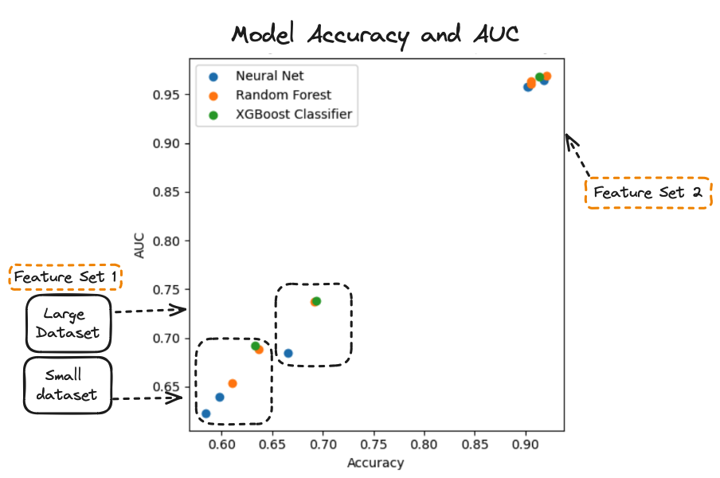
Model Performance
Feature Set 1 Accuracy
XGBoost: 0.6931
Random Forest: 0.6916
Neural Net: 0.6656
Feature Set 1 & 2 Accuracy
Random Forest: 0.9208
Neural Net: 0.9184
XGBoost: 0.9135
Impact of increasing data volume on accuracy:
Feature set 1: ~7%
Feature set 2: ~1.5%

Slide 9



Application
Cost to Passengers: $16.7 billion Cost to Airlines: $8.3 billion Cost to Environment: 5529 tons fuel
Operational Decision Making
Proactive planning, recovery, and passenger notification
Mitigate impact from delays
Improve operational processes
Route Improvements – Fuel Optimization
Crew Management
Schedule adjustments
Predictive analytics for identifying crew-related issues
Continuous Learning and Improvement
Introduce new data sources
Monitoring and adjusting

